Slide 1

Metric Store Using DBT Cloud

Slide 2
Agenda & Action Points
Metric Store:
XXXXXX is working on digital cockpit platform where any user can define their own KPIs and get the value out of it. XXXXXX wants to define the metric at one place and make it discoverable for the downstream applications to fetch it whenever they want. Metric should be unique to avoid duplicity. So, having a Metric Store will add value here. Metric : should be calculated in databricks through a pipeline and gets pushed to be stored in Postgres. Metrics should be defined in a Metric Model and the model should run on top of either Snowflake/Big Query/Databricks & Store it in Postgres. XXXXXX wants to bring the Metric component out of DBT and build an enterprise Metric Store so that Metric can be reused, and the reusability becomes a key differentiator. Currently Digital Cockpit doesn't have this capability where users can define their own KPIs. A oneclick Dashboard which can connect to a backend Metric Store can help.
Build a demo on the framework that will be parameterized to only subset the required columns or measure based on business needs.

Slide 3









Metric Store Architecture Using DBT Semantic Metric Layer
Data Sources
Data Targets
Data Consume
2
BigQuery
BigQuery
Custom Reports
1
3
4
Snowflake
Snowflake
dbt-metric
metricflow
dbt-utils
DBT - Semantic Metric Layer
PostgreSQL
PostgreSQL
Databricks
Databricks

Slide 4
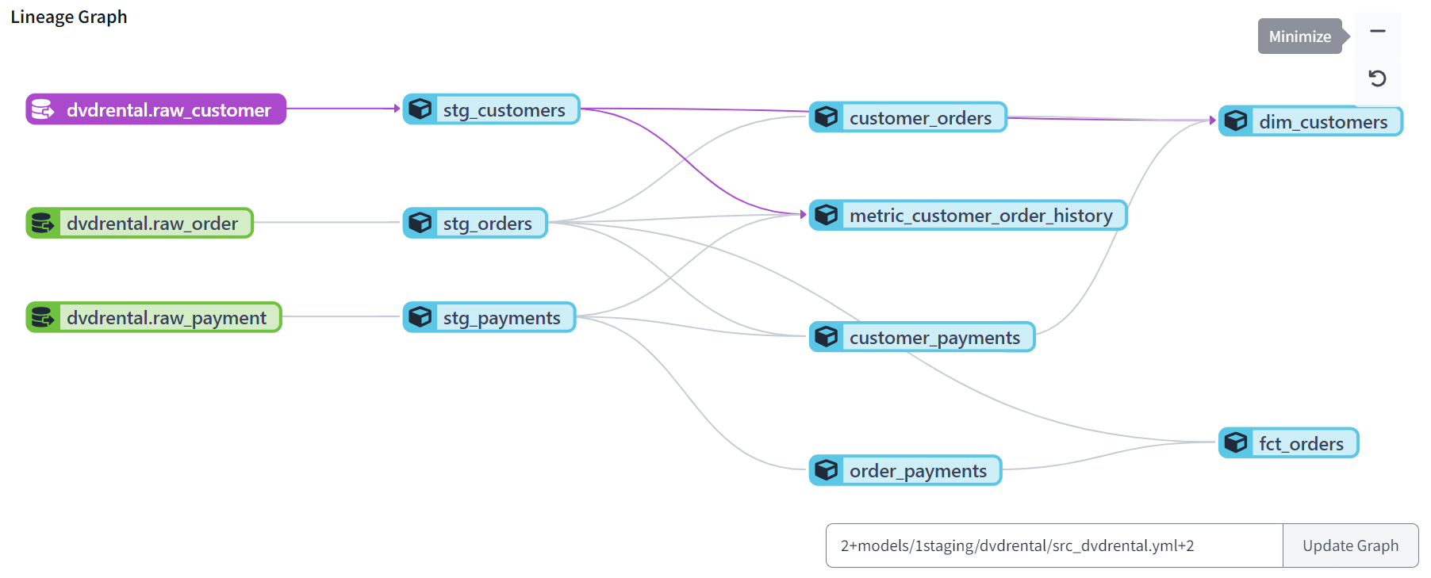
Connecting to Raw Datasets , Data Curation, Creating Facts and Dimensions

Slide 5
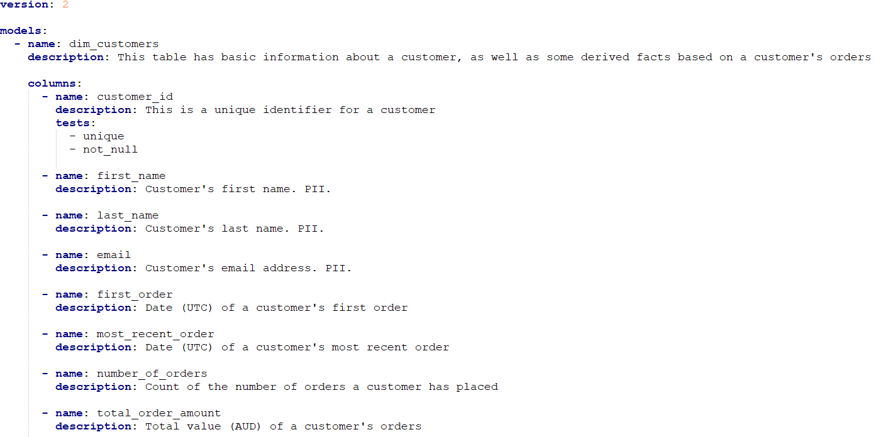
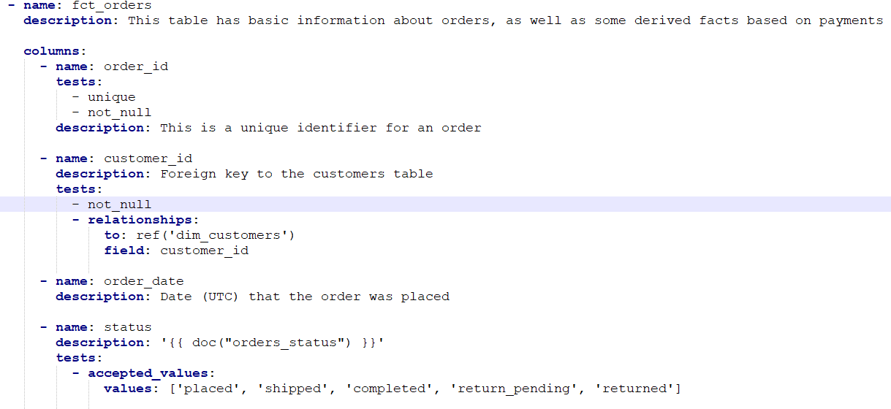
Defining Facts , Dimensions, Relations, Grains in YML Model For Metric

Slide 6
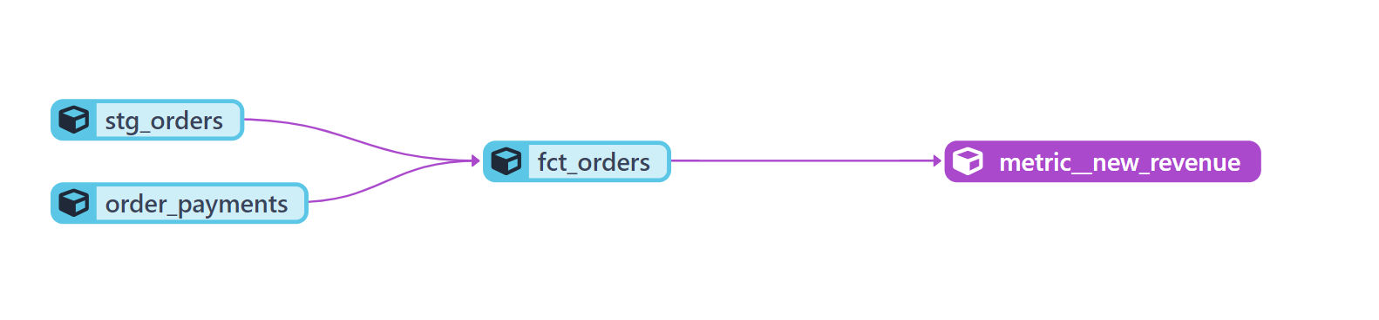
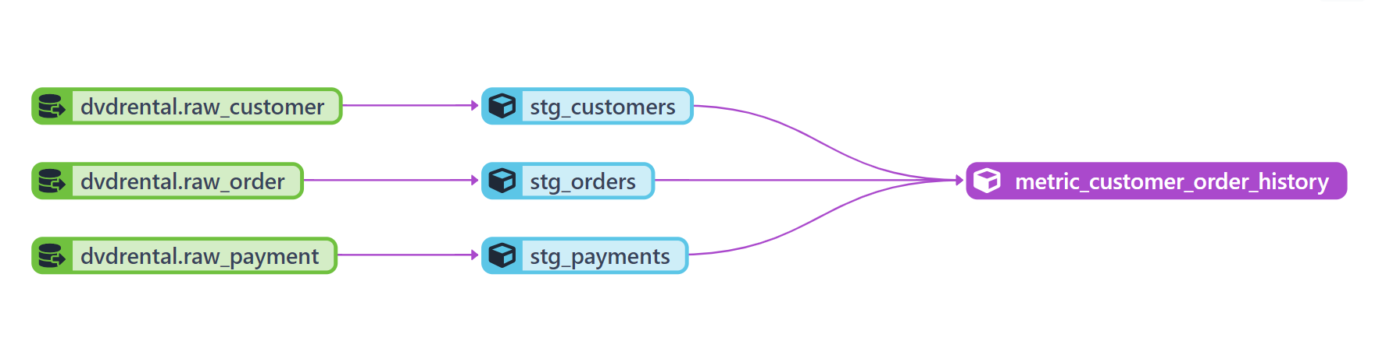
Revenue Metric From Order Fact
Creating Metrics Using Facts & Dimensions Data
Customer Order History Metric

Slide 7
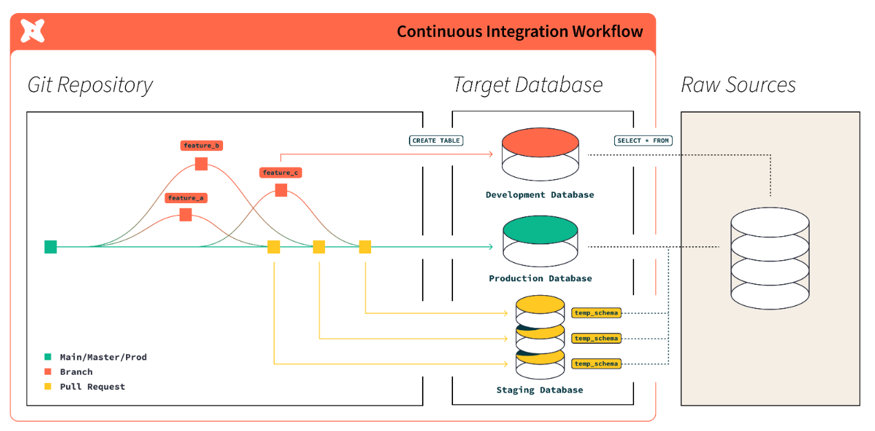
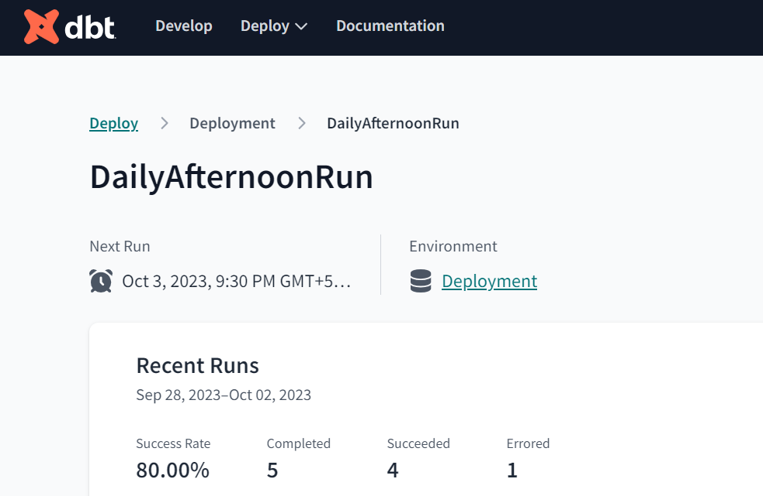
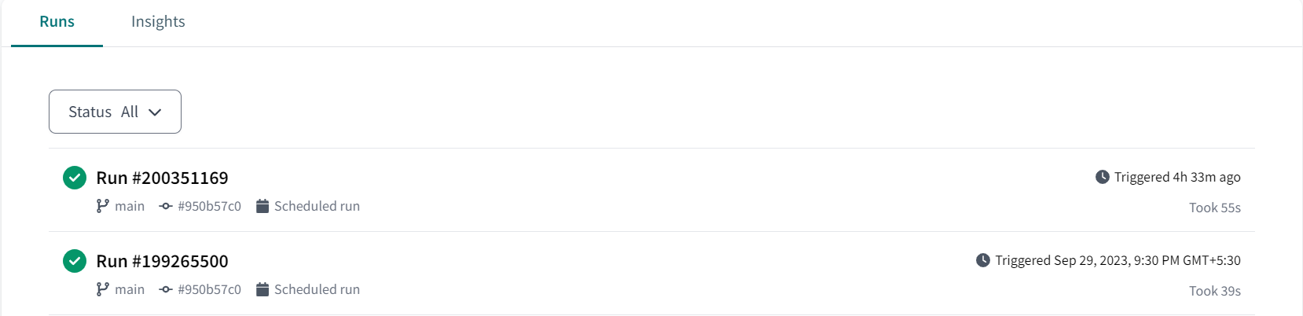
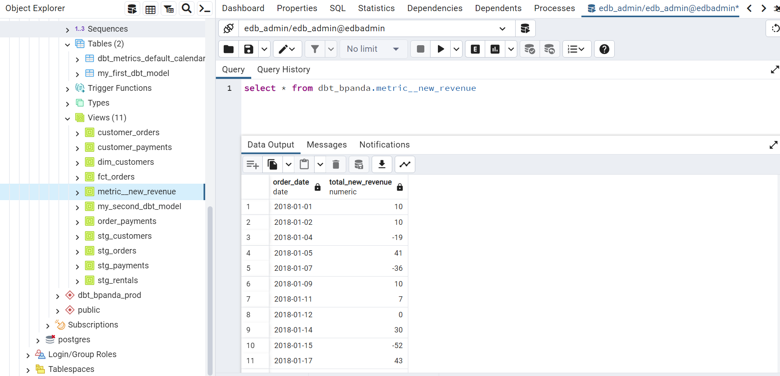
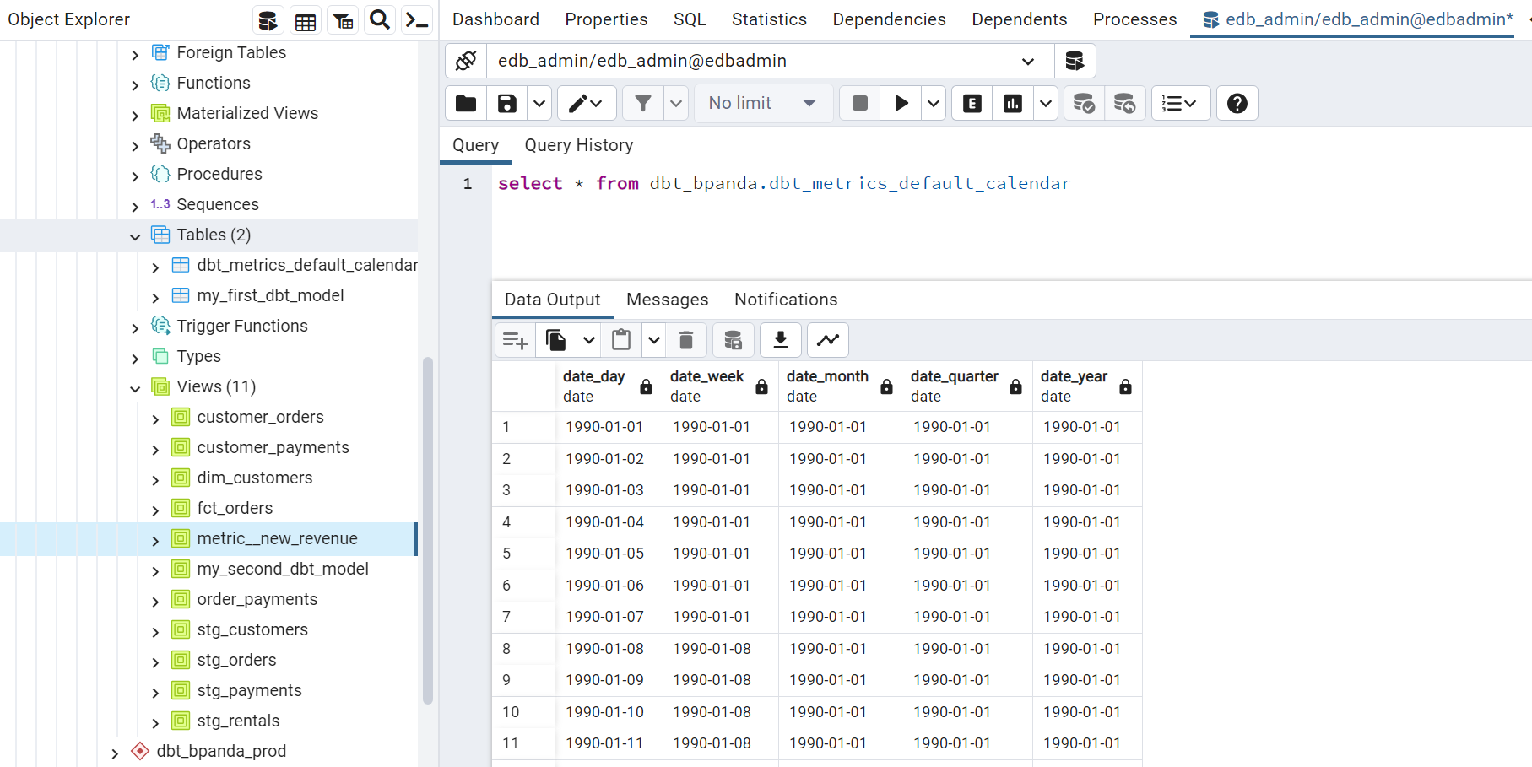
Metric Store Deployment Architecture & Query it in Production Postgres

Slide 8
Thank You

